Slide 1



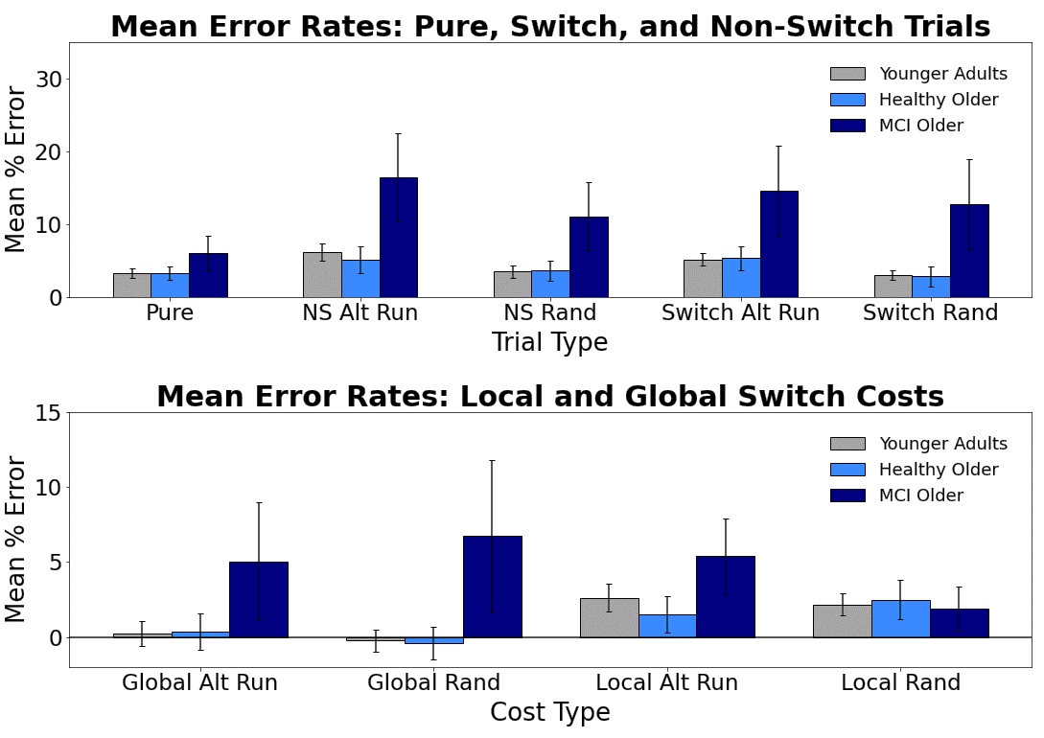
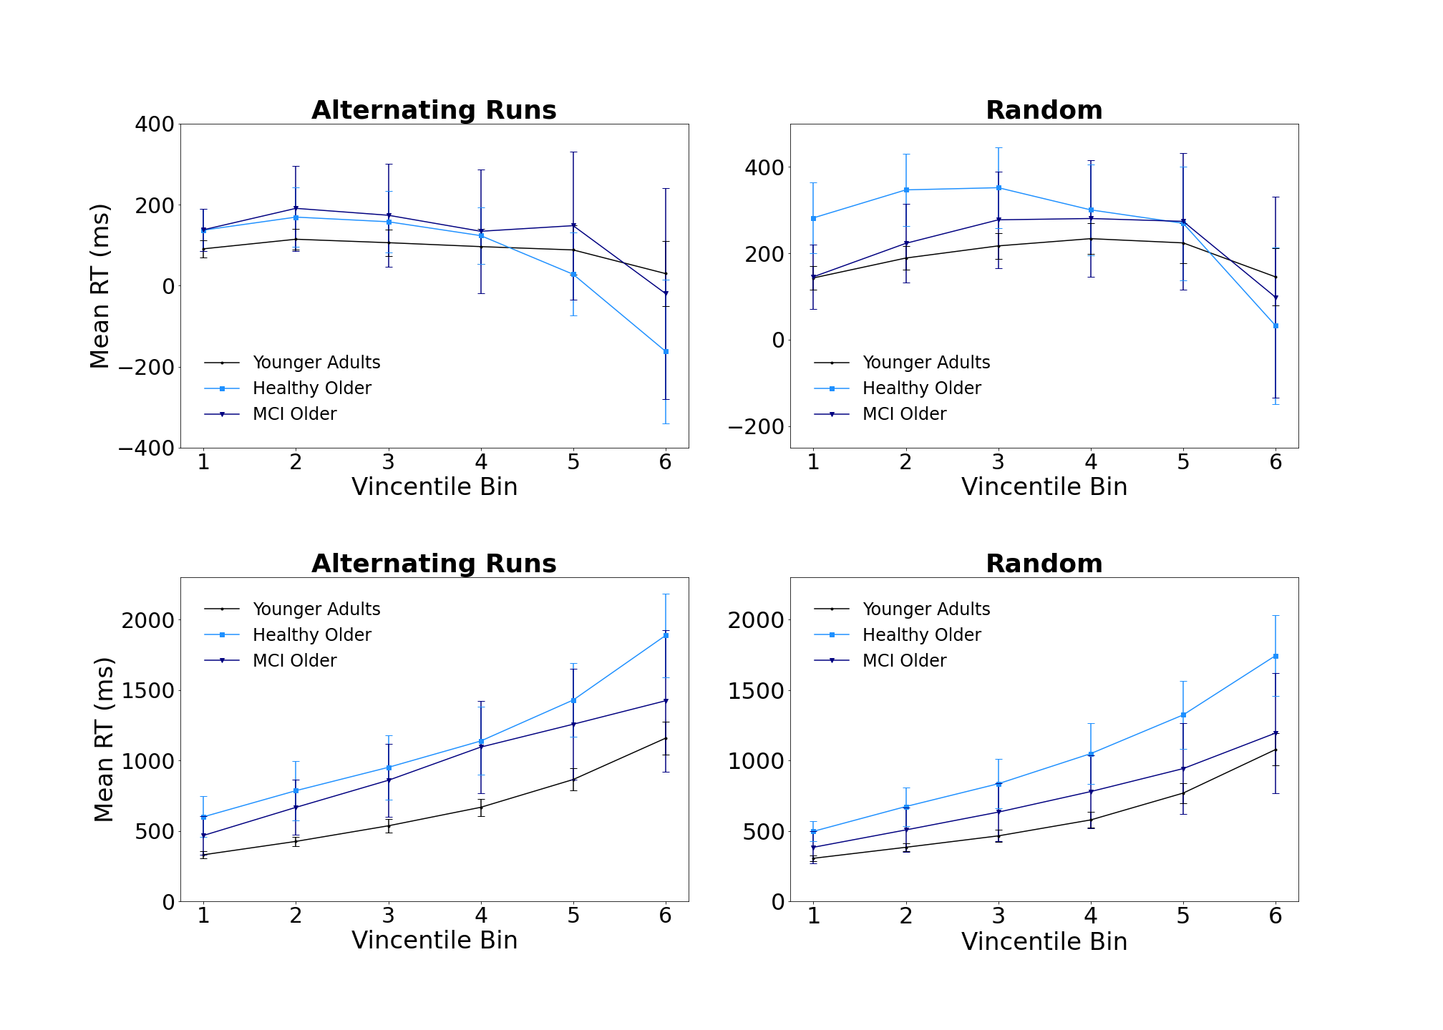
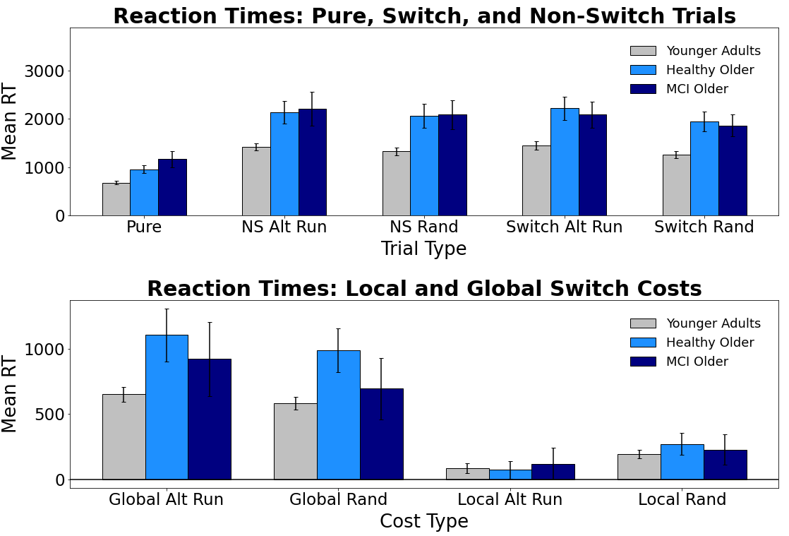
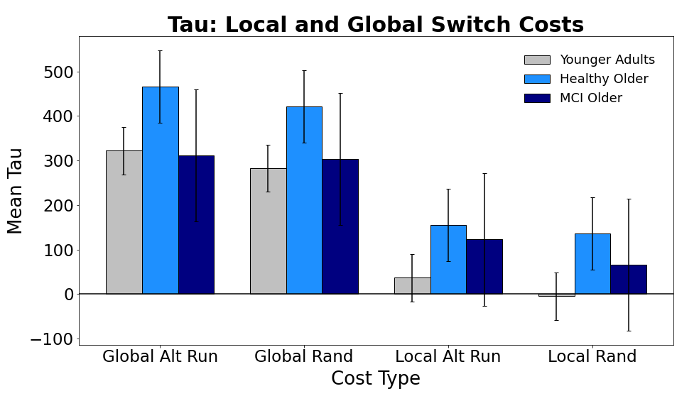
Evaluating Switch Costs using Alternating-Runs and Random Sequencing in the Consonant-Vowel/Odd-Even Task in Younger, Healthy Older, and Mildly Impaired Older Adults
Jacob M. Namias, Nicholas P. Maxwell, & Mark J. Huff
Introduction
Results: Mean Errors
Vincentile Plots
In the Consonant-Vowel/Odd-Even task (CVOE, Minear & Shah, 2008), participants view bivalent stimuli (e.g., A 08) and quickly classify the letter (Consonant/Vowel) or number (Odd/Even). Because participants complete pure blocks (i.e.., all trials are the same task) and switch blocks (i.e.., switching between both classification tasks), the CVOE can be used to compare global and local switch costs. Global costs (i.e., non-switch trials - pure trials) denote the cost of keeping multiple task-sets active in working memory. Alternatively, local costs (i.e., switch trials - non-switch trials) reflect task-set reconfiguration processes that occur from switching tasks within the same block.
CVOE switch trials are often presented using a predictable, alternating runs sequence (e.g., CV, CV, OE, OE, CV, CV). The present study compares this to random switching in which there is no discernable pattern. We compared differences on each switch task between three groups: younger adults, healthy older adults, and MCI older adults. In addition to assessing changes in mean errors and RTs, we also assessed changes in switch costs using Vincentile plots and an ex-Gaussian analysis. We expected that participants would find the random switching task more difficult, and that these difficulties would be reflected in greater error rates and RTs compared to alternating runs switching. Furthermore, given breakdowns in working memory and attentional control processes that are associated with cognitive impairments, we expected that MCI older adults would particularly struggle with the random switch task. Thus, we expected that differences in switch costs previously found using alternating runs would be particularly exaggerated for these individuals when switching was non-predictive.
Local Switch Costs
Global Switch Costs
Bars = 95% CI
Bars = 95% CI
Results: Mean RTs
Bars = 95% CI
Participants
Conclusions
Group | n | M Age | % Female | M MoCA
Younger Adults | 89 | 19.67 | 66% | 28.36
Healthy Older | 33 | 73.92 | 75% | 27.75
MCI Older | 26 | 75.88 | 41% | 24.00
Overall, MCI older adults produced more errors compared to both younger and healthy older adults. Additionally, both older adult groups had slower RTs relative to younger adults, regardless of trial type. However, within each group, mean error rates and RTs did not differ between alternating runs and random switching. Regarding switch costs, global error costs did not differ between switch tasks as function of age group. For local error costs, however, MCI older adults’ switch costs were greater for predictive vs. non-predictive switching. Finally, for mean RT switch costs, global costs did not differ as function of switch type. However, younger and healthy older adults showed greater local RT costs when switching was random, suggesting that the random switch task was more taxing towards task-set reconfiguration processes.
Vincentile plots showed that local costs decreased for all groups. However, analysis of these plots failed to detect a three-way interaction between cost type, bin, and group, indicating that decreases across bins did not differ between predictive and random switching. For global costs, all groups showed steady increases across bins, with no differences occurring between switch types, with the three-way interaction again non-significant. Finally, fitting response times to an ex-gaussian distribution revealed that tau (i.e., positive tail of the RT distribution) was greater for global costs vs. local costs and higher for healthy older adults relative to younger adults. However, for both local and global costs, tau did not differ as function of switch type. Thus, it appears that while local RT costs may be slower for predictive switching when individuals are not impaired, these differences are not reflected in distributional analyses, and switch task performance largely does not differ between predictive and random switching.
Materials
Letters: A, D, E, H, I, J, I, P, S, U
Numbers: 1-99
Bars = 95% CI
Pair
D 15
A 04
E 23
H 36
Task
CV
CV
OE
OE
Correct Response
C
V
O
E
Ex-Gaussian Analysis
General Method
Pure Trials
(2 Blocks)
Switch Blocks
(2 Blocks)
MoCA
Note: Participants completed four blocks (CV, OE, Alt Runs, and Random). The first two blocks always contained pure trials (CV or OE). The final two blocks were always switch blocks (Alt Runs or Random). MoCA = Montreal Cognitive Assessment
Bars = 95% CI
Correspondence regarding this project can be addressed to jacob.namias@usm.edu.
More info available at: www.macapsych.com | https://osf.io/yrdsz/

